Slide 1
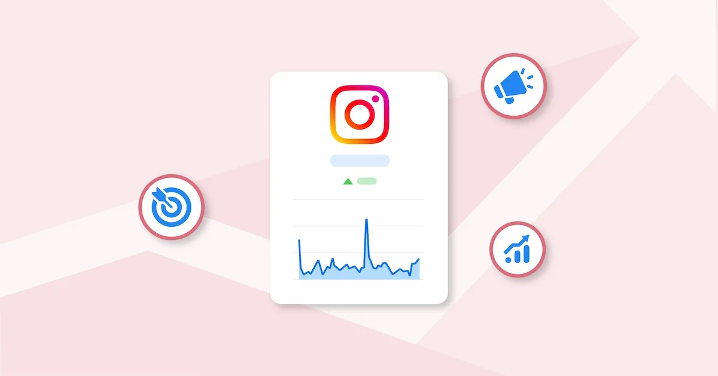
INSTAGRAM USER ANALYTICS(PROJECT NUMBER 2)
BY VENKATESH HMS
DATED ON:26-05-2025

Slide 2
PROJECT DESCRIPTION
Our project aims to simulate the role of a data analyst working with Instagram's product and marketing teams.
Using SQL and MySQL Workbench, the goal is to analyze user interaction and engagement on the platform, enabling business teams to make data-driven decisions.
The insights provided will support marketing strategies, feature development, user retention, and investment decisions.
This is also a great HandsOn to learn the real-time problem-solving and debugging of SQL errors, such as foreign key constraints and duplicates, which are vital in live data environments.

Slide 3
Our project also reinforces the ability to derive actionable insights from relational data through JOINs, subqueries, grouping, and aggregation techniques.

Slide 4
APPROACH
DATABASE SETUP:
I imported and executed the provided sql schema and data into MySql workbench(using the dataset provided by TRAINITY)
I created and populated 7 Tables namely:users, photos, likes, comments, tags, photo_tags, and follows.
QUERY EXECUTION:
I executed each of the sql queries corresponding to each of the business questions need to be answered(ie. The sql tasks given)
For simplicity purpose I inserted only 200 rows for the tables as the datas given in the dataset were too much.(first I made dryrun with 50 rows then only I swiched to 200 rows).

Slide 5
OUTPUT COLLECTION:
After that the output screenshots and the code snippets were captured .
The explanations were wriiten for each task along with what tables were used and joins etcc which operations were performed were all highlighted.

Slide 6
TECH STACK USED IN PROJECT
MYSQL 8.0 CE:
This was Chosen for its integrated GUI, which simplifies query execution, result viewing, and database schema management.
SQL(STRUCTURED QUERY LANGUAGE):
Used for querying and manipulating relational data to answer business questions(ie. The sql tasks to be answered)
WINDOWS 11 OS:
This is the Platform for running MySQL Workbench and documentation tools.

Slide 7
SQL TASKS ANSWERS
A. MARKETING ANALYSIS:
LOYAL USER REWARD
SELECT *
FROM users
ORDER BY created_at ASC
LIMIT 5;
This query Identifies the 5 earliest users based on account creation date and reports them

Slide 8
INACTIVE USER ENGAGEMENT
SELECT *
FROM users
WHERE id NOT IN (SELECT DISTINCT user_id FROM photos);
This query Targetes inactive users who haven't uploaded any photos.
CONTEST WINNER DECLARATION
This query helps us in Declaring the user with the most liked photo as the contest winner

Slide 9
SELECT p.id AS photo_id, p.user_id, COUNT(l.photo_id) AS like_count
FROM photos p
JOIN likes l ON p.id = l.photo_id
GROUP BY p.id
ORDER BY like_count DESC
LIMIT 1;
HASHTAG REASEARCH

Slide 10
SELECT tag_id, COUNT(*) AS usage_count
FROM photo_tags
GROUP BY tag_id
ORDER BY usage_count DESC
LIMIT 5;
This query helps us in Suggesting the 5 most popular hashtags for brand promotion.
AD CAMPIAGN LAUNCH

Slide 11
SELECT DAYNAME(created_at) AS day_of_week, COUNT(*) AS registrations
FROM users
GROUP BY day_of_week
ORDER BY registrations DESC
LIMIT 1;
This query Recommends the best weekday to launch ads based on user sign-ups.

Slide 12
INVESTOR METRICS
USER ENGAGEMENT
SELECT ROUND(COUNT(*) / (SELECT COUNT(*) FROM users), 2) AS avg_posts_per_user
FROM photos;
This query helps us in Revealing average content contribution per user.

Slide 13
BOTS AND FAKE ACCOUNTS
SELECT user_id
FROM likes
GROUP BY user_id
HAVING COUNT(*) = (SELECT COUNT(*) FROM photos);
This query helps us in Identifying suspicious users who liked every photo as possible bots.

Slide 14
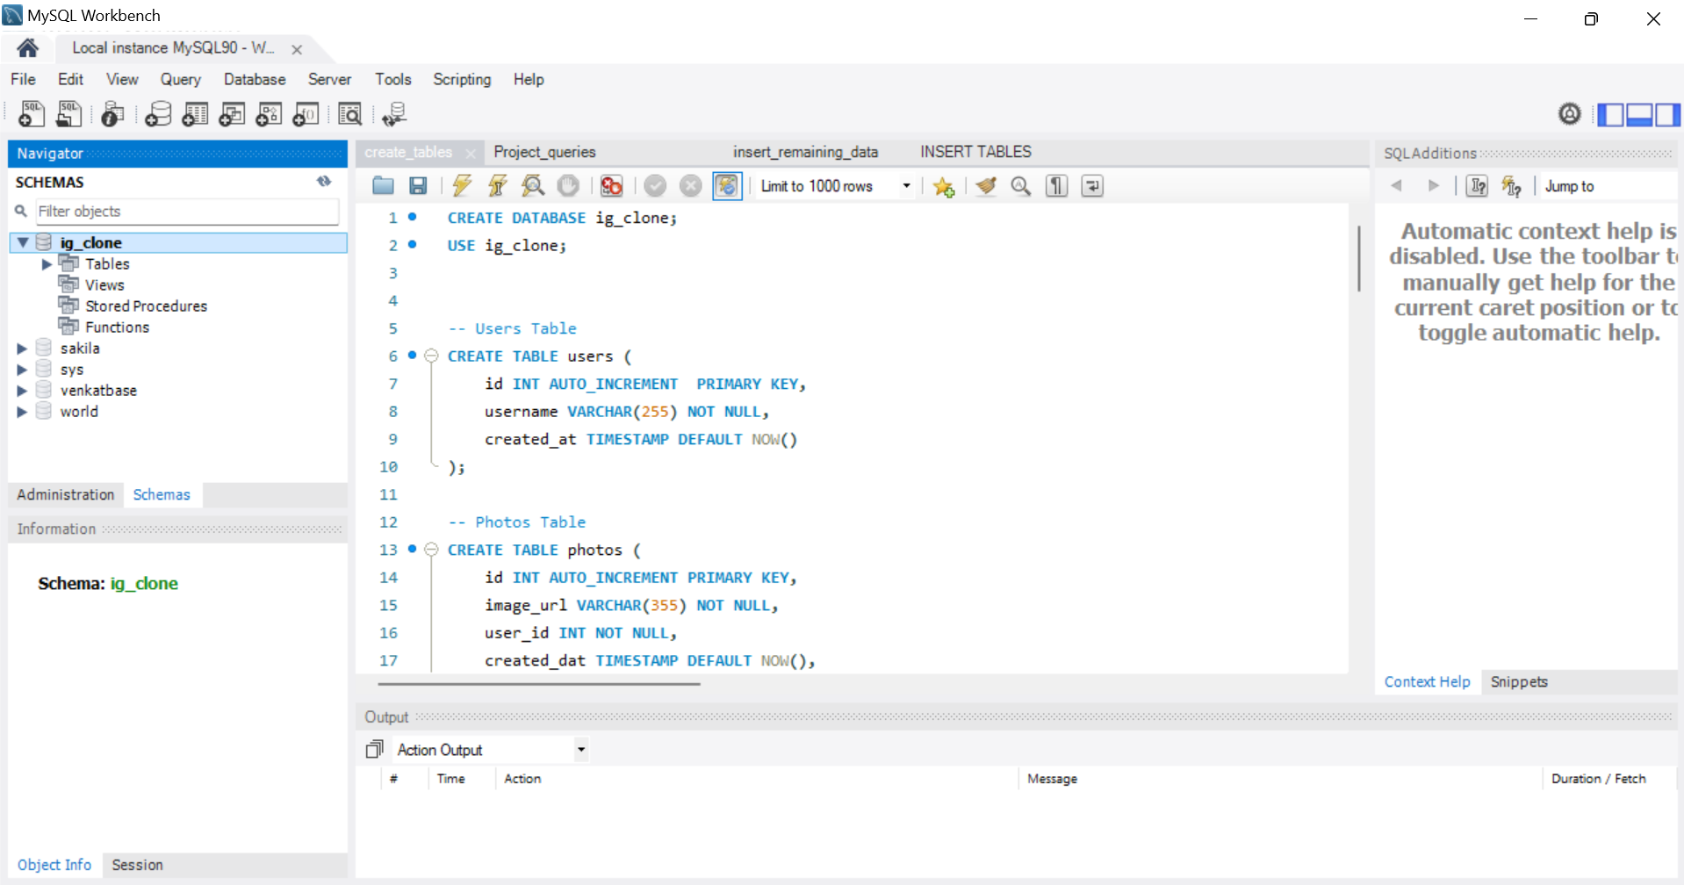
SQL WORKBENCH AND OUTPUT SCREENSHOTS

Slide 15
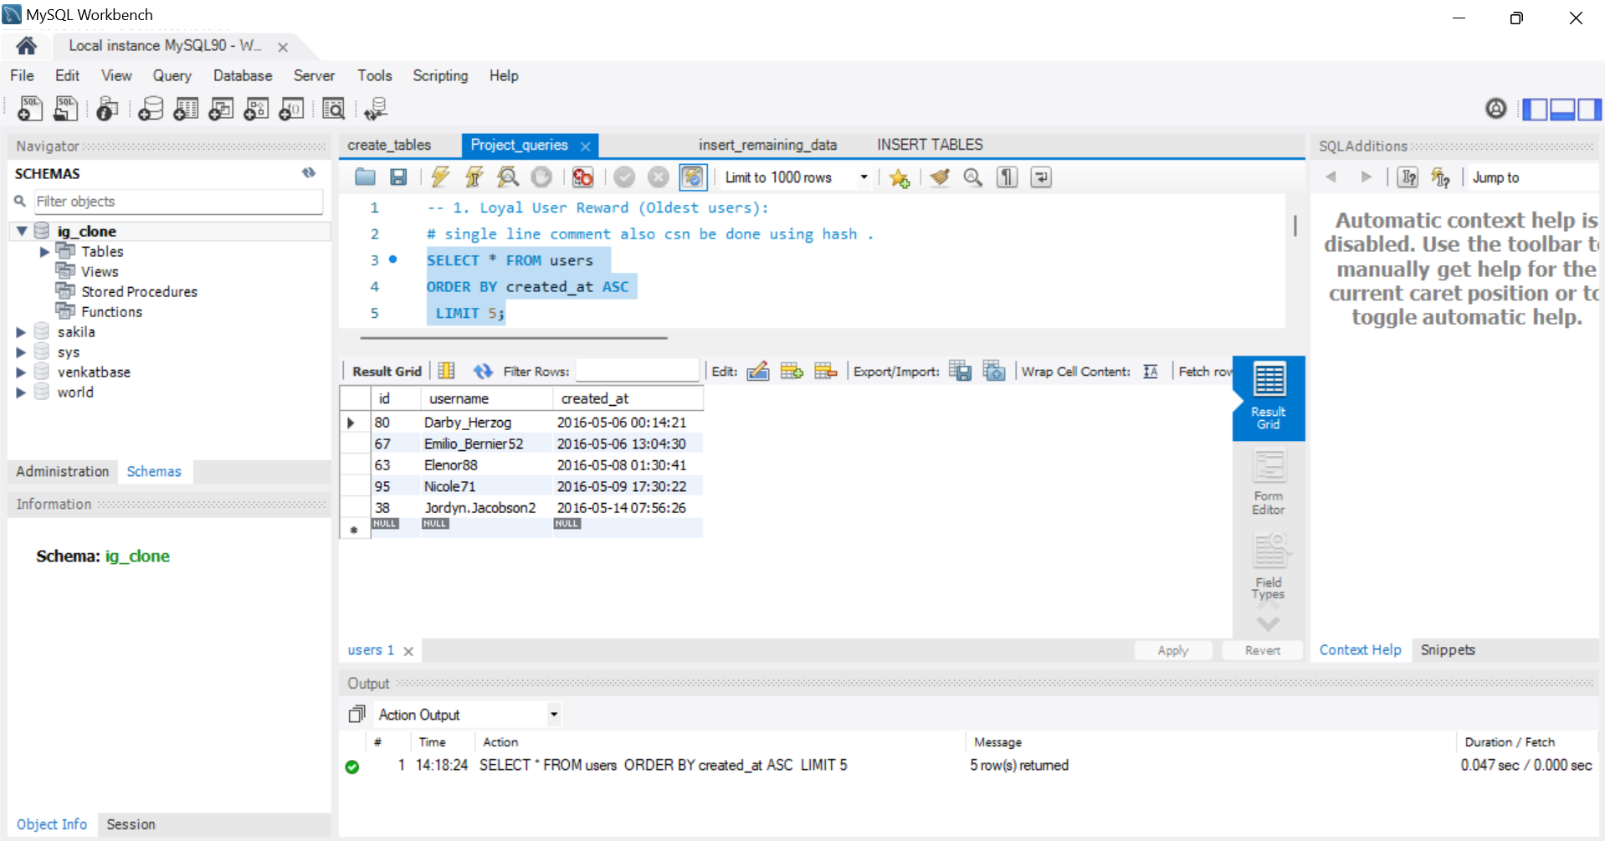

Slide 16
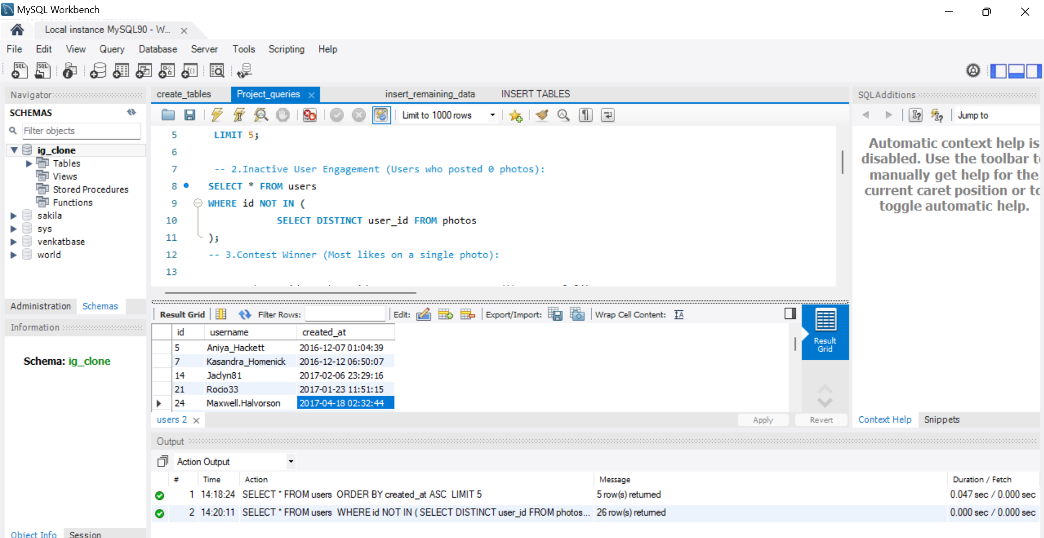

Slide 17
SEE ALL 26 ROWS OF QUERY 2 (PREV IMG)
5 | Aniya_Hackett | 2016-12-07 01:04:39
7 | Kasandra_Homenick | 2016-12-12 06:50:07
14 | Jaclyn81 | 2017-02-06 23:29:16
21 | Rocio33 | 2017-01-23 11:51:15
24 | Maxwell.Halvorson | 2017-04-18 02:32:44
25 | Tierra.Trantow | 2016-10-03 12:49:21
34 | Pearl7 | 2016-07-08 21:42:01
36 | Ollie_Ledner37 | 2016-08-04 15:42:20
41 | Mckenna17 | 2016-07-17 17:25:45
45 | David.Osinski47 | 2017-02-05 21:23:37
49 | Morgan.Kassulke | 2016-10-30 12:42:31
53 | Linnea59 | 2017-02-07 07:49:34
54 | Duane60 | 2016-12-21 04:43:38
57 | Julien_Schmidt | 2017-02-02 23:12:48
66 | Mike.Auer39 | 2016-07-01 17:36:15
68 | Franco_Keebler64 | 2016-11-13 20:09:27
71 | Nia_Haag | 2016-05-14 15:38:50
74 | Hulda.Macejkovic | 2017-01-25 17:17:28
75 | Leslie67 | 2016-09-21 05:14:01
76 | Janelle.Nikolaus81 | 2016-07-21 09:26:09
80 | Darby_Herzog | 2016-05-06 00:14:21
81 | Esther.Zulauf61 | 2017-01-14 17:02:34
83 | Bartholome.Bernhard | 2016-11-06 02:31:23
89 | Jessyca_West | 2016-09-14 23:47:05
90 | Esmeralda.Mraz57 | 2017-03-03 11:52:27
91 | Bethany20 | 2016-06-03 23:31:53

Slide 18
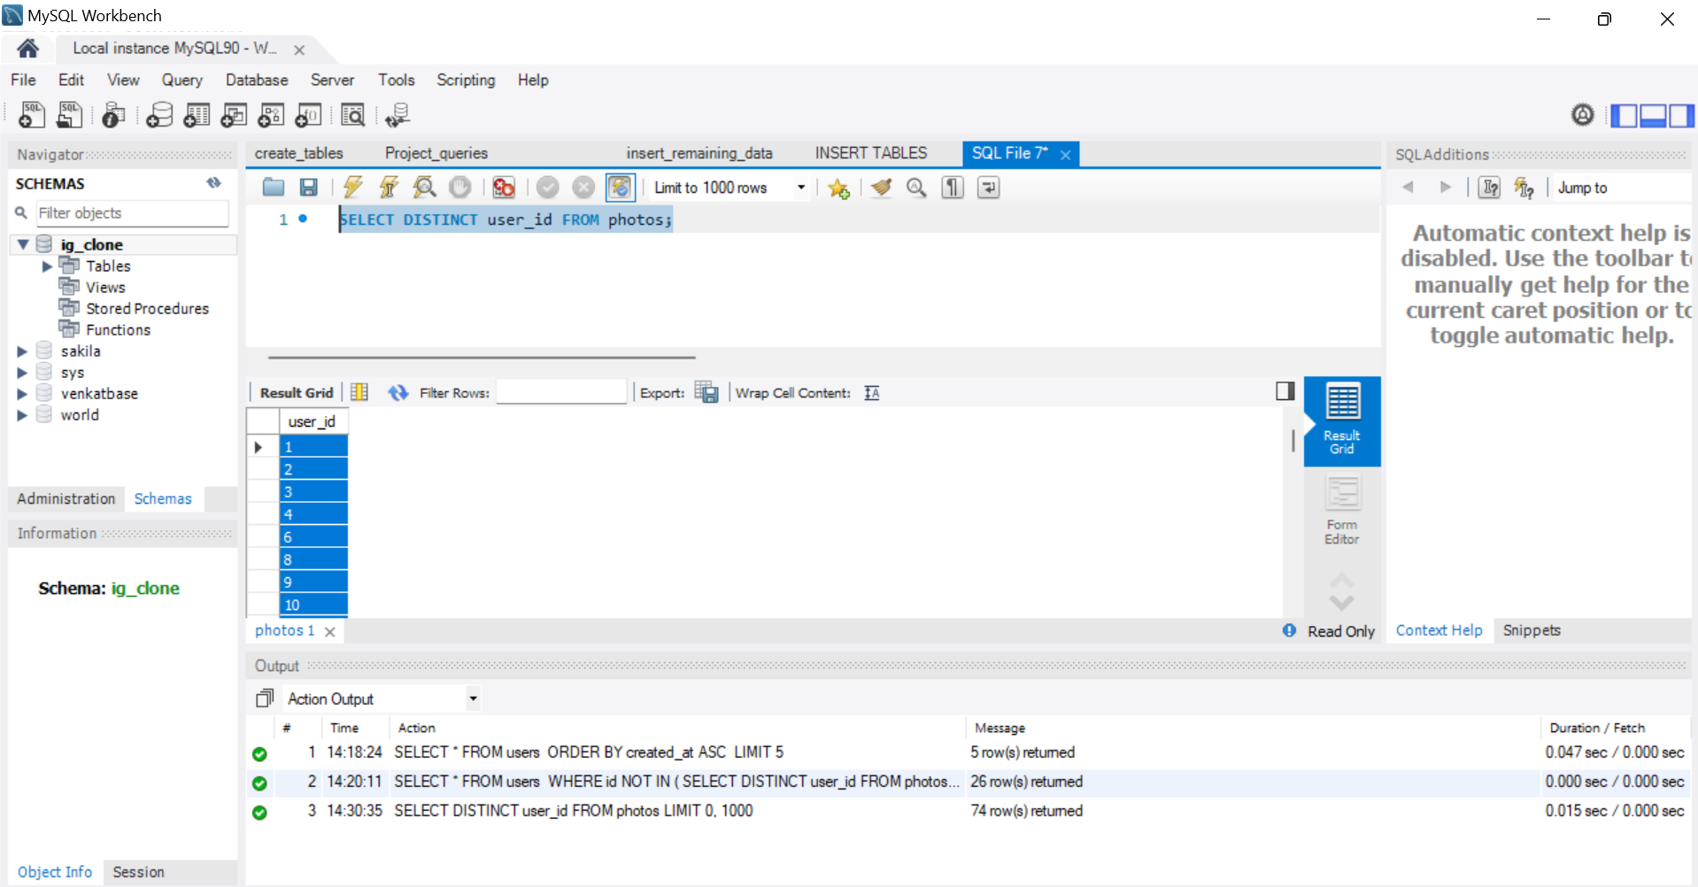
SUBQUERY EXECUTION (PG NO: 16)

Slide 19
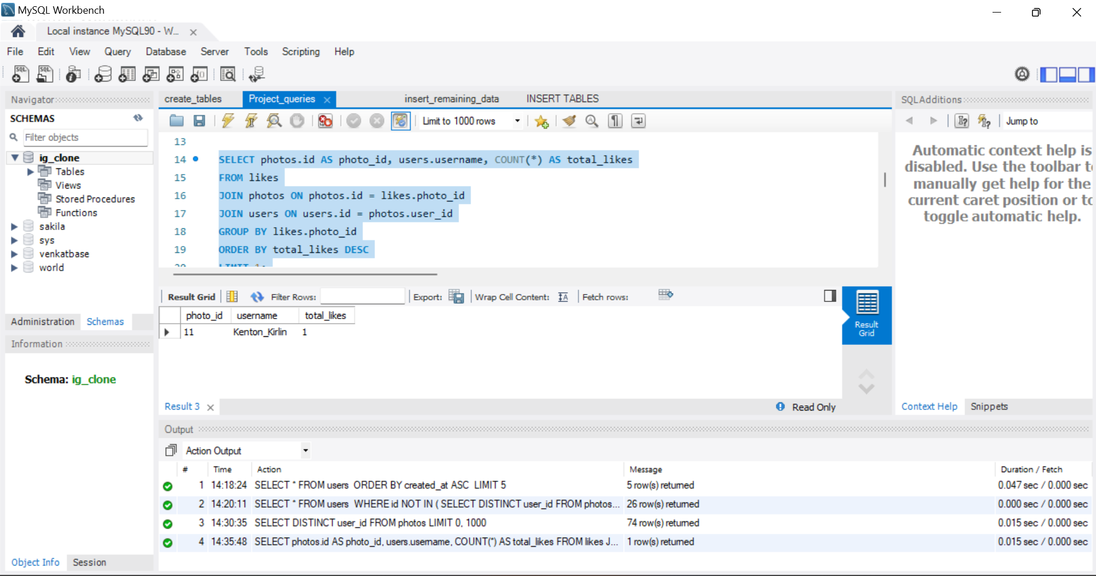
3. Contest winner (3A)

Slide 20
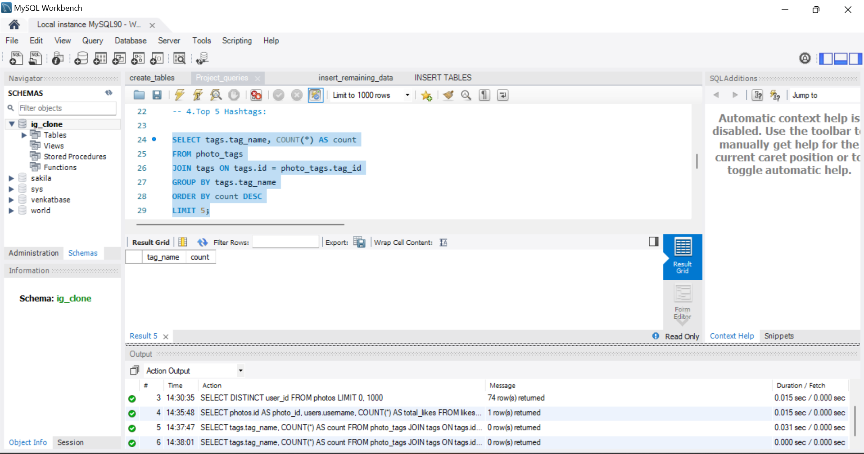
4 A)THERE IS NO TOP 5 HASHTAGS

Slide 21
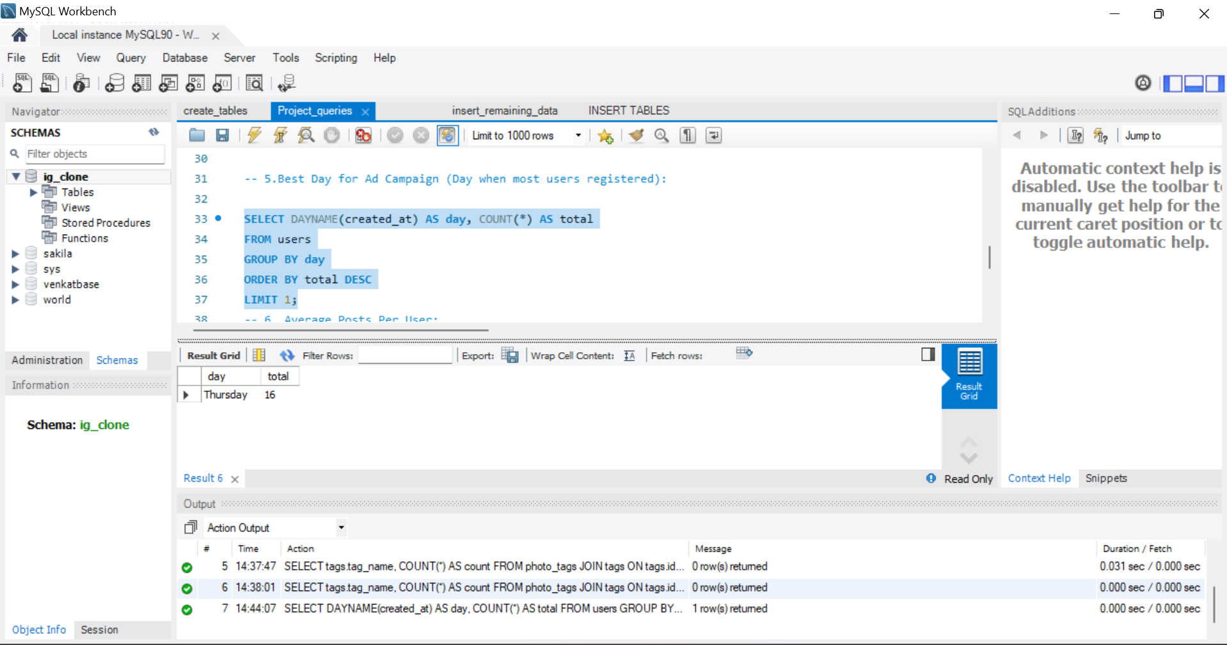
5.A)

Slide 22
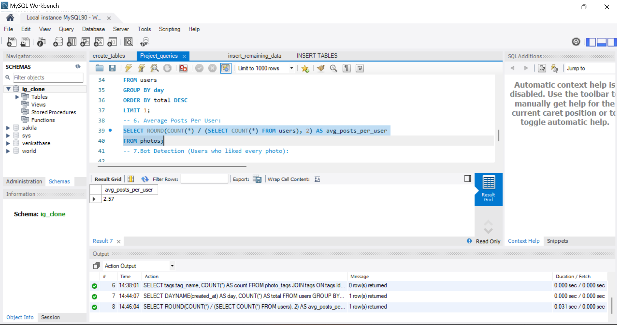
1 B)

Slide 23
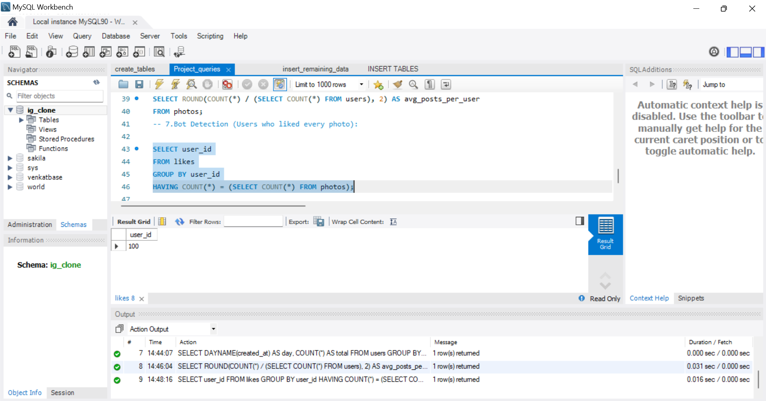
2B)

Slide 24
INSIGHTS
Through this project, I developed a deeper understanding of how SQL can be used to analyze real-world user behavior in social media platforms. By writing and executing optimized queries, I was able to extract meaningful insights from relational datasets.
Key findings include:
Identifying loyal users based on account creation dates, useful for retention strategies.
Spotting inactive users who could be re-engaged through targeted marketing.

Slide 25
Understanding peak days for user sign-ups, which can guide ad scheduling.
Discovering the most frequently used hashtags, which is valuable for brand collaborations.
Detecting potentially automated users who liked every photo, pointing to possible bot activity.
Overall, the project strengthened my ability to turn raw data into actionable insights while reinforcing SQL skills such as JOINs, subqueries, and aggregation — all of which are crucial for a data analyst role.

Slide 26
RESULT
This SQL project successfully demonstrated practical database querying skills to extract business insights. The findings can support marketing decisions, user engagement efforts, and data governance (e.g., bot detection). By translating raw data into meaningful information, this project mimics real-world analytical tasks .
This is very helpful for me
Additionally, the project provided hands-on experience with relational database design, data integrity constraints, and debugging real-time errors, which are crucial in any production-grade environment. Working through each task enhanced my problem-solving abilities and reinforced the importance of clean, accurate data in making strategic decisions.

Slide 27
Lastly, I gained confidence in using SQL to identify behavioral patterns, engagement trends, and anomalies, which can inform future product and marketing strategies
NOTE: ALONG WITH PPT I HAVE ALSO ADDED THE QUERIES(INSERT,CREATE , SQL TASKS ANSWERS) AS SEPARATE DATASET FILE IN GOOGLE DRIVE , U CAN VERIFY WHAT I HAVE DONE IN THAT ALSO ALONG WITH THE OUTPUT SCREENSHOTS PROVIDED.

